Slide 1
Operation Analytics and Investigating Metric Spike

Slide 2
Project Description
Operational Analytics is a crucial process that involves analyzing a company's end-to-end operations. This analysis helps identify areas for improvement within the company.
One of the key aspects of Operational Analytics is investigating metric spikes. This involves understanding and explaining sudden changes in key metrics, such as a dip in daily user engagement or a drop in sales.
In this project, there are various datasets and tables, so that I can analyze the data and provide valuable insights that can help improve the company's operations and understand sudden changes in key metrics.

Slide 3
Approach
The approach towards this project is to build the tables and analyze the data thoroughly to understand business problem.
Tech-Stack Used
This project is done in MySQL Workbench 8.0 (Version 8.0.25) for creating queries. And the report is submitted in Power Point Presentation

Slide 4
Case Study 1: Job Data Analysis

Slide 5
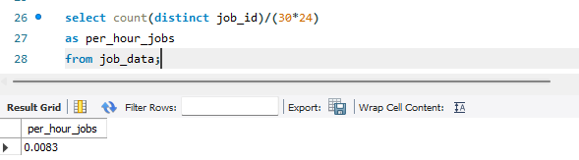
A. Jobs Reviewed Over Time
The number of jobs reviewed per hour for each day in November 2020.

Slide 6
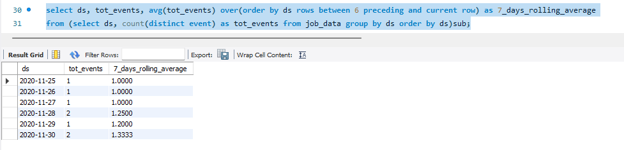
B. Throughput Analysis
The 7-day rolling average of throughput (number of events per second).
This can be helpful in understanding trends over time, as it provides a longer term perspective.

Slide 7
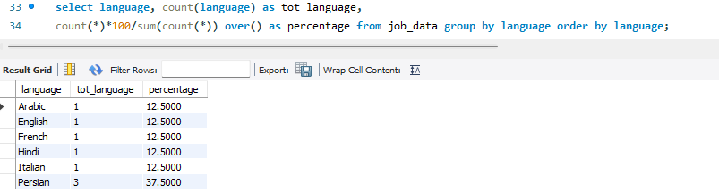
C. Language Share Analysis
The percentage share of each language in the last 30 days.

Slide 8
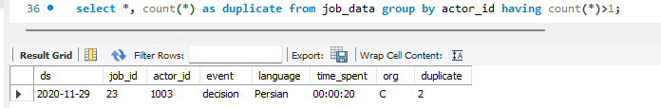
D. Duplicate Rows Detection
Identify duplicate rows in the data.

Slide 9
Case Study 2: Investigating Metric Spike

Slide 10
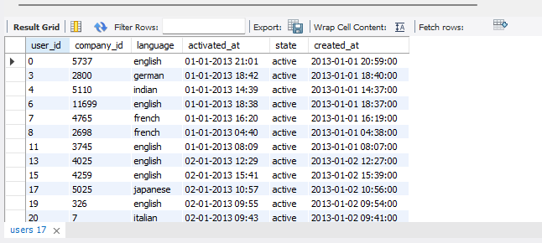
Creating Users Table

Slide 11
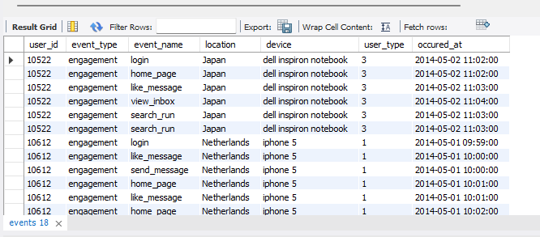
Creating Events Table

Slide 12
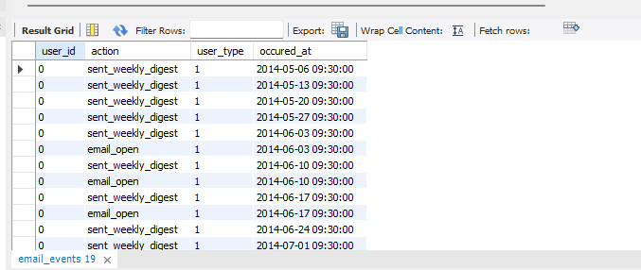
Creating Email_Events Table

Slide 13
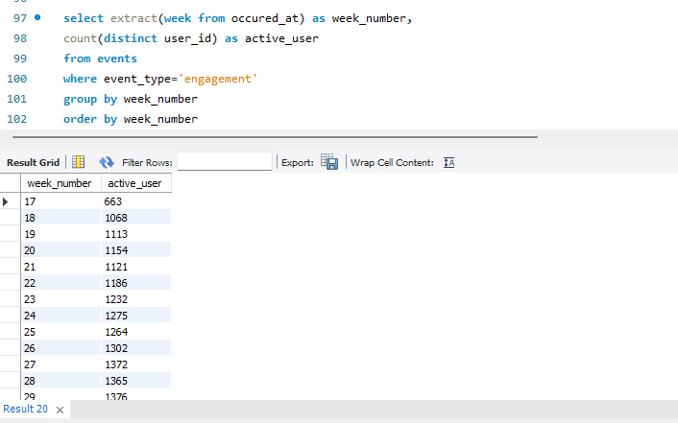
A. Weekly User Engagement
The activeness of users on a weekly basis.

Slide 14
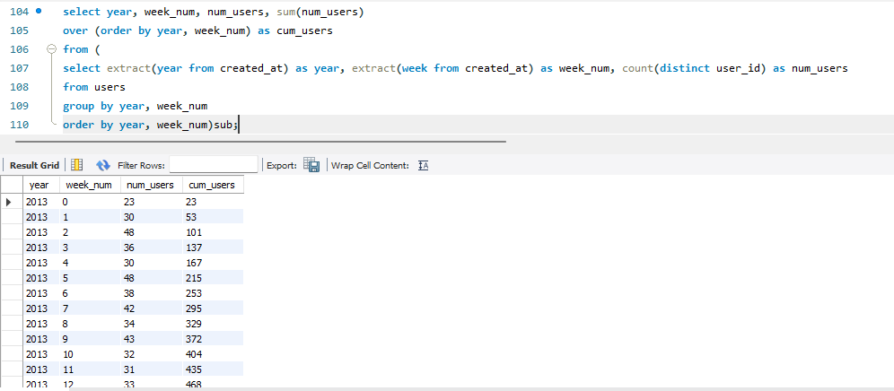
B. User Growth Analysis
Analyze the growth of users over time for a product.

Slide 15
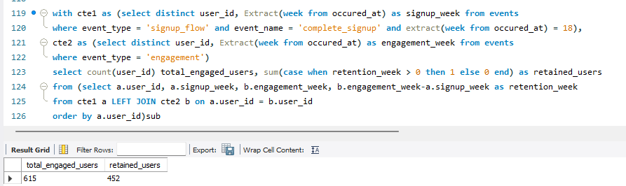
C. Weekly Retention Analysis
Analyze the retention of users on a weekly basis after signing up for a product.

Slide 16
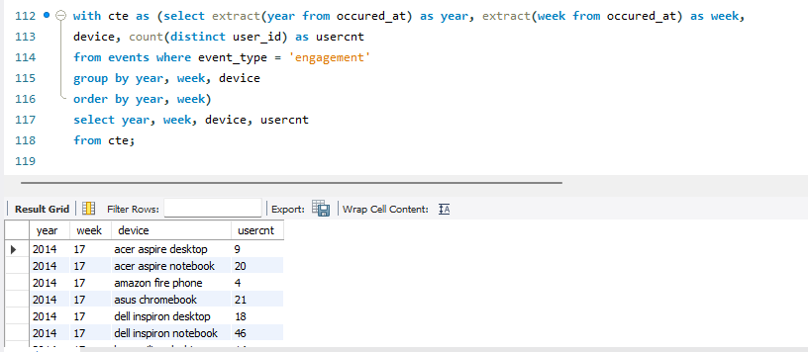
D. Weekly Engagement Per Device
Measure the activeness of users on a weekly basis per device.

Slide 17
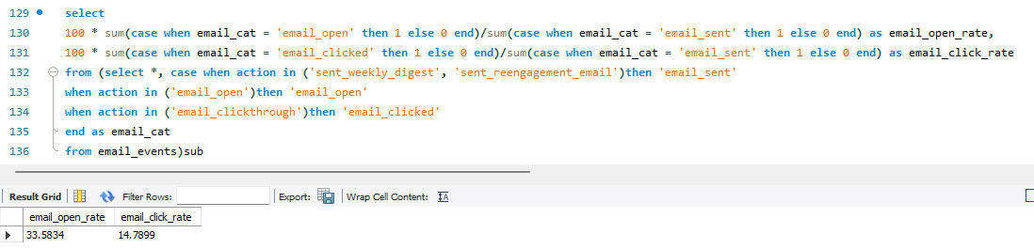
E. Email Engagement Analysis
Analyze how users are engaging with the email service.

Slide 18
Insights
From these project I get to know the following:
Case Study 1:
Less than 0.01 jobs were reviewed each hour of the day throughout the month of November.
Helpful in understanding trends over time, as it provides a longer term perspective.
Persian language has the highest share among other languages.
There are only 2 duplicates in the dataset.

Slide 19
Insights
From these project I get to know the following:
Case Study 2:
Week 30 has the highest number of 1467 users engagement and week 35 has the lowest number of 104 users engagement.
Week 33 of year 2024 has the greatest number of 1261 active users who engage with the products and week 35 of year 2024 has the lowest number of 18 active users who engage with the products.
Total engaged users are greater than total retained users
Week 30 of year 2024 has the highest number of 322 user engagement for the products and device being used was MacBook Pro
Total 33.58% emails were opened and 14.79% were clicked

Slide 20
Result
This project gave me an idea of how an analyst and business works on real time data. It gave me an understanding how analysis works and how to get insights from any given data.

Slide 21
THANK YOU

